Slide 1
Database Systems
COMP 3010E FALL 2025
Lecture 13 The relational algebra, Query Processing and Query Optimization

Slide 2
Final Exam
Week 13 Thursday (Nov. 27), 16:00-18:00
H301
Closed book, Closed note, No electronic devices
Questions based on materials, homework, labs
True or false, Fill in blanks, Multiple choices, SQL writing/reading, Brief text answers.
Brief review in the last lecture.

Slide 3
Agenda
The Relational Algebra
  Relational algebra operations
Query Processing
  Basic steps in query processing
  Measures of query cost
  Select operation
  Join operation
Query Optimization
  Transformation of relational expressions
  Logical query optimization
  Physical query optimization
  Cost estimation

Slide 4
The Relational Algebra
  A procedural language consisting of a set of operations that take one or two relations as input and produce a new relation as their result. It is the theoretical model for database queries and SQL.
$$π_{Name,CourseName}\left(σ_{CourseID=c2}\left(R⋈S\right)\right)$$
Relation R
Relation S

Slide 5

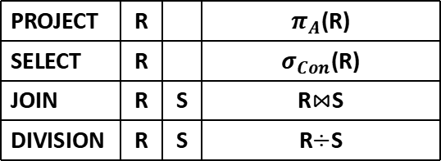
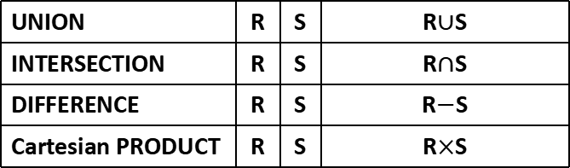
Relational Algebra Operations
  Basic operations in relational algebra are divided into set operations and pure relational operations.
① Set Operations
② Pure Relational Operations
UNION | R | S | R$∪$S
INTERSECTION | R | S | R$∩$S
DIFFERENCE | R | S | R$−$S
Cartesian PRODUCT | R | S | R$×$S
PROJECT | R |  | $π_{A}$(R)
SELECT | R |  | $σ_{Con}$(R)
JOIN | R | S | R$⋈$S
DIVISION | R | S | R$÷$S
    rename: $ρ$

Slide 6
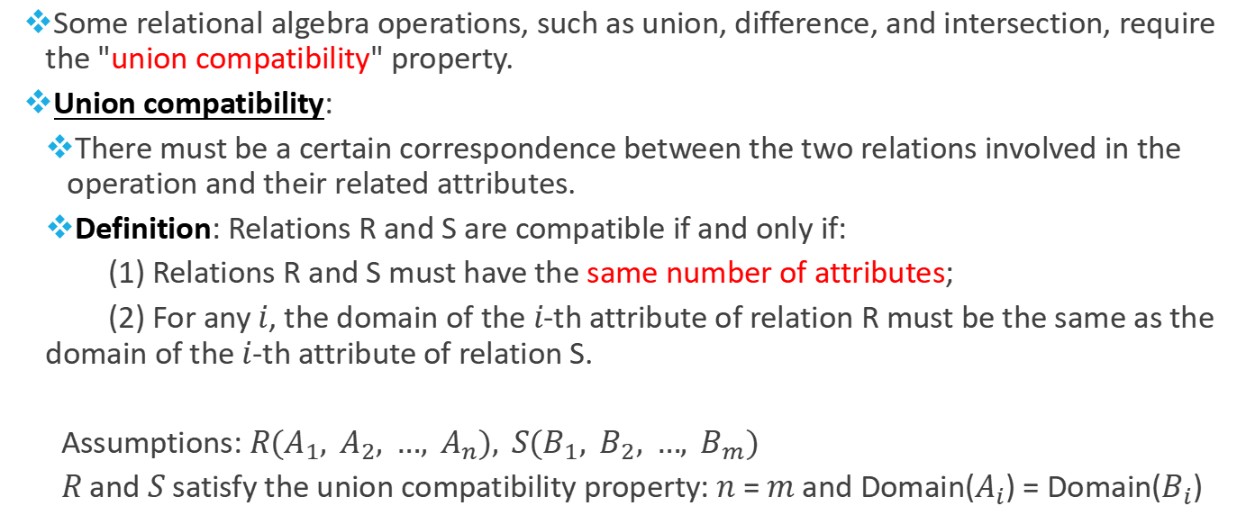
The Relational Algebra
  Some relational algebra operations, such as union, difference, and intersection, require the "union compatibility" property.
  Union compatibility:
    There must be a certain correspondence between the two relations involved in the operation and their related attributes.
    Definition: Relations R and S are compatible if and only if:
    (1) Relations R and S must have the same number of attributes;
    (2) For any $i$, the domain of the $i$-th attribute of relation R must be the same as the domain of the $i$-th attribute of relation S.
  Assumptions: $R(A_{1}, A_{2}, …, A_{n}), S(B_{1}, B_{2}, …, B_{m})$
  $R$ and $S$ satisfy the union compatibility property: $n$ = $m$ and Domain($A_{i}$) = Domain($B_{i}$)

Slide 7
The Relational Algebra
  Example
  STUDENT(SID char(10), Sname char(8), Age smallint)
  PROFESSOR(PID char(10), Pname char(8), Age smallint)
  The relation STUDENT and relation PROFESSOR are compatible because:
  (1) Both relations R and S have 3 attributes.
  (2) The fields of attribute SID in relation R and attribute PID in relation S are both char(10).
  (3) The fields of attribute Sname in relation R and attribute Sname in relation S are both char(8).
  (4) The fields of attribute Age in relation R and attribute Age in relation S are both char(3).

Slide 8
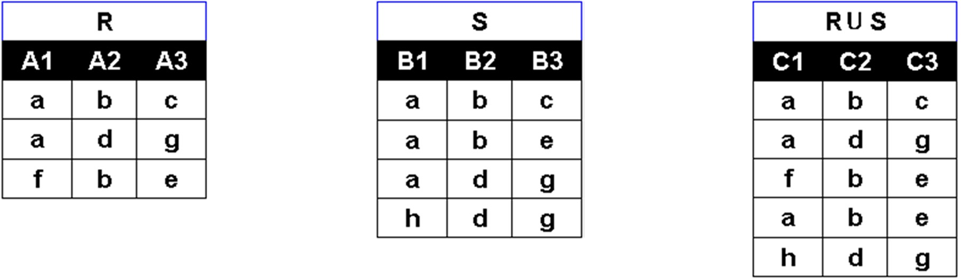
Relational Algebra Operations
Set Operation: Union
  Mathematical description: 𝑹⋃𝑺={𝒕|𝒕∈𝑹 ⋁ 𝒕∈𝑺}, where 𝒕 is a tuple.
  The union operation combines the tuples of two relations into a single relation, removing duplicate tuples during the merge.
  The result of the operations 𝑹⋃𝑺 and 𝑺⋃𝑹 is the same relation.

Slide 9
Example (Union)
Search for information on all students who have joined the basketball club or guitar club.
R(Students participating in the basketball club)
Sno | Sname | Ssex | Sage | Dno | Sclass
210130101 | Bob | M | 21 | 03 | 301
210130102 | Marry | F | 19 | 03 | 301
210130103 | Tom | M | 20 | 03 | 301
210140201 | Jerry | M | 18 | 04 | 402
210140202 | Steve | M | 21 | 04 | 402
210140203 | Lily | F | 19 | 04 | 402
R∪S(Students participating in basketball or guitar clubs)
Sno | Sname | Ssex | Sage | Dno | Sclass
210130101 | Bob | M | 21 | 03 | 301
210130102 | Marry | F | 19 | 03 | 301
210130103 | Tom | M | 20 | 03 | 301
210140201 | Jerry | M | 18 | 04 | 402
210140202 | Steve | M | 21 | 04 | 402
210140203 | Lily | F | 19 | 04 | 402
210120301 | Lucy | F | 18 | 02 | 203
210120302 | Sam | M | 20 | 02 | 203
210120303 | Zoe | F | 19 | 02 | 203
S(Students participating in the guitar club)
Sno | Sname | Ssex | Sage | Dno | Sclass
210120301 | Lucy | F | 18 | 02 | 203
210120302 | Sam | M | 20 | 02 | 203
210120303 | Zoe | F | 19 | 02 | 203
210130101 | Bob | M | 21 | 03 | 301
210130102 | Marry | F | 19 | 03 | 301
210130103 | Tom | M | 20 | 03 | 301

Slide 10
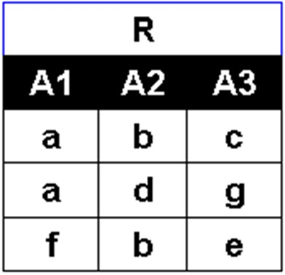
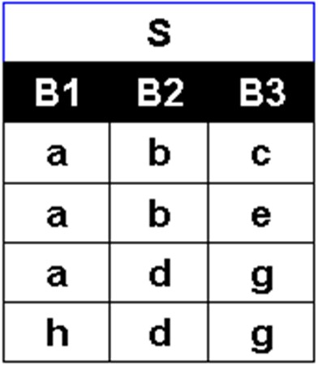
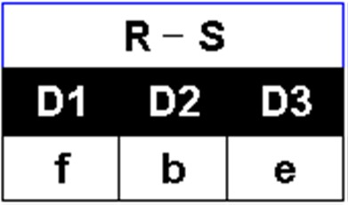
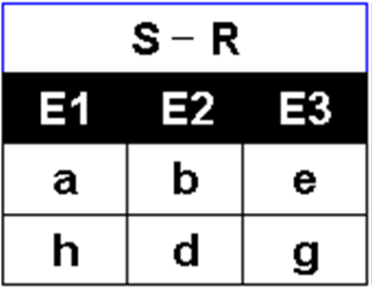

Relational Algebra Operations
Set Operation: Difference
  Mathematical description: $R−S=\{t|t∈R ∧ t∉S\}$, where 𝒕 is a tuple.
  The results of the operations 𝑹-𝑺 and 𝑺-𝑹 are distinct.

Slide 11
Example (Difference)
Search for information on students who only participate in the basketball club and not the guitar club.
Search for information on students who only participate in the guitar club and not the basketball club.
R(Students participating in the basketball club)
R-S(Students participating in the basketball club and not the guitar club)
Sno | Sname | Ssex | Sage | Dno | Sclass
210130101 | Bob | M | 21 | 03 | 301
210130102 | Marry | F | 19 | 03 | 301
210130103 | Tom | M | 20 | 03 | 301
210140201 | Jerry | M | 18 | 04 | 402
210140202 | Steve | M | 21 | 04 | 402
210140203 | Lily | F | 19 | 04 | 402
Sno | Sname | Ssex | Sage | Dno | Sclass
210140201 | Jerry | M | 18 | 04 | 402
210140202 | Steve | M | 21 | 04 | 402
210140203 | Lily | F | 19 | 04 | 402
S(Students participating in the guitar club)
S-R(Students participating in the guitar club and not the basketball club)
Sno | Sname | Ssex | Sage | Dno | Sclass
210120301 | Lucy | F | 18 | 02 | 203
210120302 | Sam | M | 20 | 02 | 203
210120303 | Zoe | F | 19 | 02 | 203
210130101 | Bob | M | 21 | 03 | 301
210130102 | Marry | F | 19 | 03 | 301
210130103 | Tom | M | 20 | 03 | 301
Sno | Sname | Ssex | Sage | Dno | Sclass
210120301 | Lucy | F | 18 | 02 | 203
210120302 | Sam | M | 20 | 02 | 203
210120303 | Zoe | F | 19 | 02 | 203

Slide 12
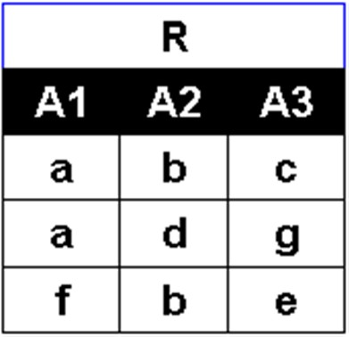
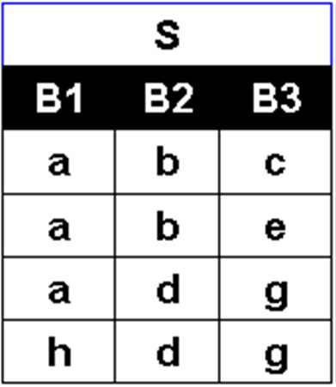
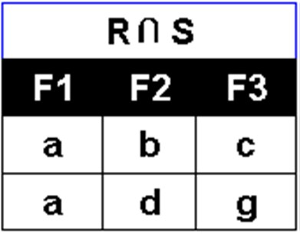
Relational Algebra Operations
Set Operation: Intersection
  Mathematical description: 𝑹∩𝑺={𝒕|𝒕∈𝑹 ∧ 𝒕∈𝑺}, where 𝒕 is a tuple.
  The intersection operation can be implemented using the difference operation: 𝑹∩𝑺=𝑹−(𝑹−𝑺)=𝑺−(𝑺−𝑹)
  The result of the operations 𝑹∩𝑺 and 𝑺∩𝑹 is the same relation.

Slide 13
Example (Intersection)
Search for information on students who participate in both the basketball club and the guitar club.
R(Students participating in the basketball club)
Sno | Sname | Ssex | Sage | Dno | Sclass
210130101 | Bob | M | 21 | 03 | 301
210130102 | Marry | F | 19 | 03 | 301
210130103 | Tom | M | 20 | 03 | 301
210140201 | Jerry | M | 18 | 04 | 402
210140202 | Steve | M | 21 | 04 | 402
210140203 | Lily | F | 19 | 04 | 402
R∩S(Students participating in both the basketball club and the guitar club)
Sno | Sname | Ssex | Sage | Dno | Sclass
210130101 | Bob | M | 21 | 03 | 301
210130102 | Marry | F | 19 | 03 | 301
210130103 | Tom | M | 20 | 03 | 301
S(Students participating in the guitar club)
Sno | Sname | Ssex | Sage | Dno | Sclass
210120301 | Lucy | F | 18 | 02 | 203
210120302 | Sam | M | 20 | 02 | 203
210120303 | Zoe | F | 19 | 02 | 203
210130101 | Bob | M | 21 | 03 | 301
210130102 | Marry | F | 19 | 03 | 301
210130103 | Tom | M | 20 | 03 | 301

Slide 14
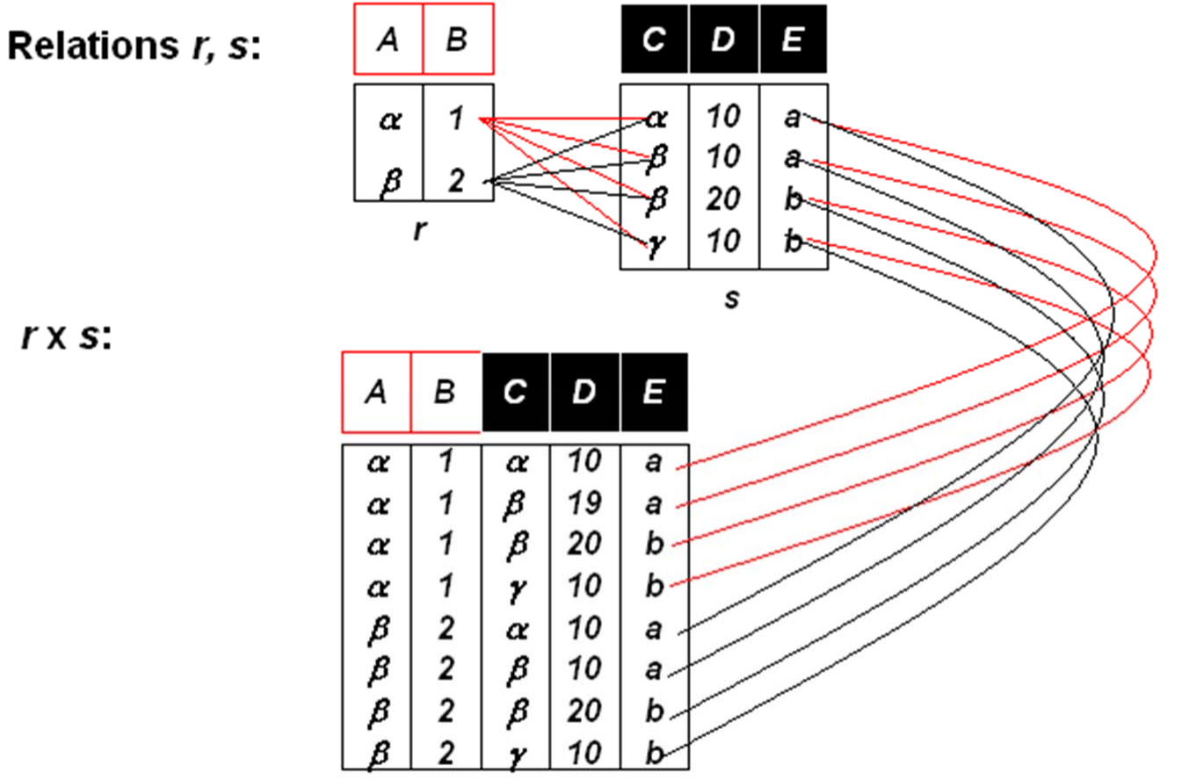
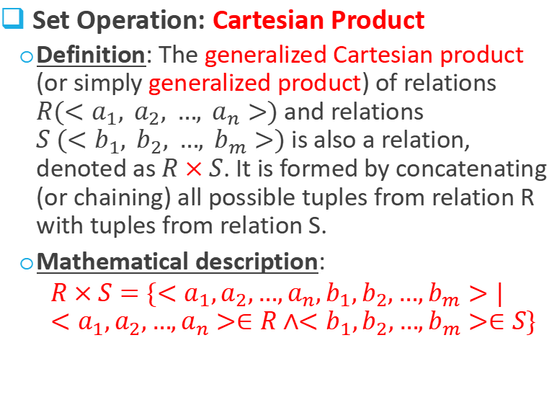
Relational Algebra Operations
Set Operation: Cartesian Product
  Definition: The generalized Cartesian product (or simply generalized product) of relations $R(<a_{1}, a_{2}, …, a_{n}>)$and relations $S (<b_{1}, b_{2}, …, b_{m}>)$is also a relation, denoted as $R×S$. It is formed by concatenating (or chaining) all possible tuples from relation R with tuples from relation S.
  Mathematical description:
  $$R×S=\{<a_{1},a_{2},…,a_{n},b_{1},b_{2},…,b_{m}>|<a_{1},a_{2},…,a_{n}>∈R∧<b_{1},b_{2},…,b_{m}>∈S\}$$

Slide 15
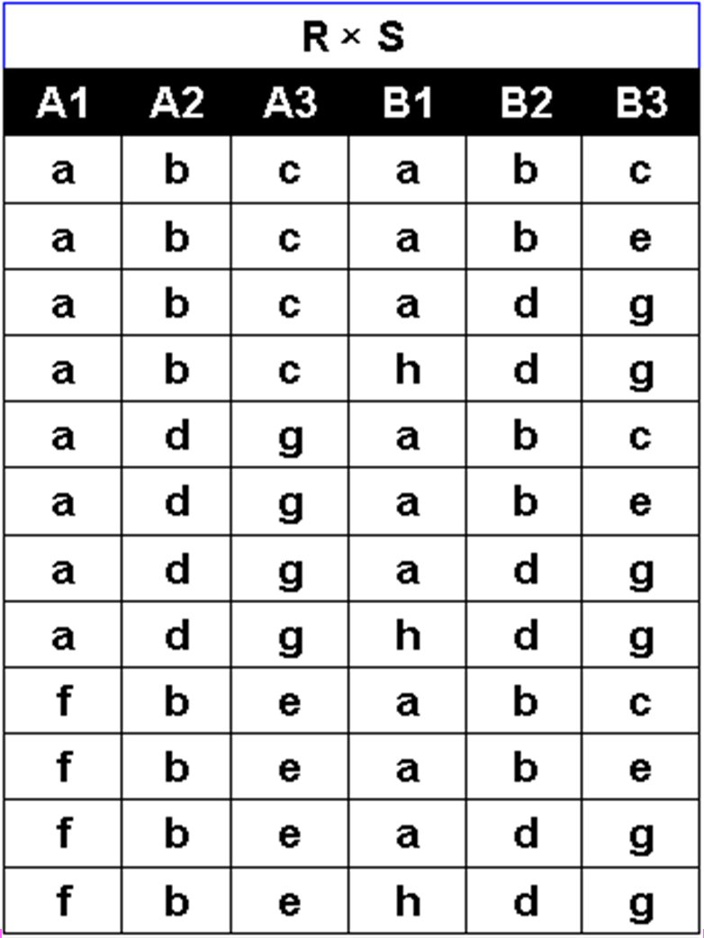
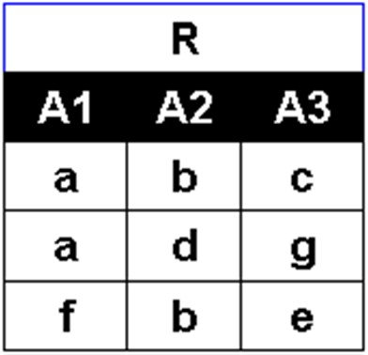

Example (Cartesian Product)
Example 1 of generalized product operation (Abstract)
Relation R has 3 tuples and a degree of 3; relation S has 4 tuples and a degree of 3. What is the value of R x S?
The number of tuples in R x S is 12, and the degree is 6.

Slide 16
Example (Cartesian Product)
Example 2 of Generalized Product Operations (Semantic)
When a retrieval involves multiple tables (such as a student table and a course table), these tables need to be concatenated or joined together before the retrieval can be performed. This is where the generalized Cartesian product operation comes in.
This forms the foundation for learning various join operations later.
Student
Sno | name | age | address
210110401 | Leo | 18 | 3010
210110402 | Emma | 17 | 3011
210110403 | Ben | 18 | 3011
(All students) (All courses)
Sno | name | age | address | Cno | Cname | Teacher | period
210110401 | Leo | 18 | 3010 | C1 | computer | Teacher1 | 52
210110401 | Leo | 18 | 3010 | C2 | physics | Teacher2 | 36
210110401 | Leo | 18 | 3010 | C3 | math | Teacher5 | 40
210110402 | Emma | 17 | 3011 | C1 | computer | Teacher1 | 52
210110402 | Emma | 17 | 3011 | C2 | physics | Teacher2 | 36
210110402 | Emma | 17 | 3011 | C3 | math | Teacher5 | 40
210110403 | Ben | 18 | 3011 | C1 | computer | Teacher1 | 52
210110403 | Ben | 18 | 3011 | C2 | physics | Teacher2 | 36
210110403 | Ben | 18 | 3011 | C3 | math | Teacher5 | 40
Course
Cno | Cname | Teacher | period
C1 | computer | Teacher1 | 52
C2 | physics | Teacher2 | 36
C3 | math | Teacher5 | 40

Slide 17
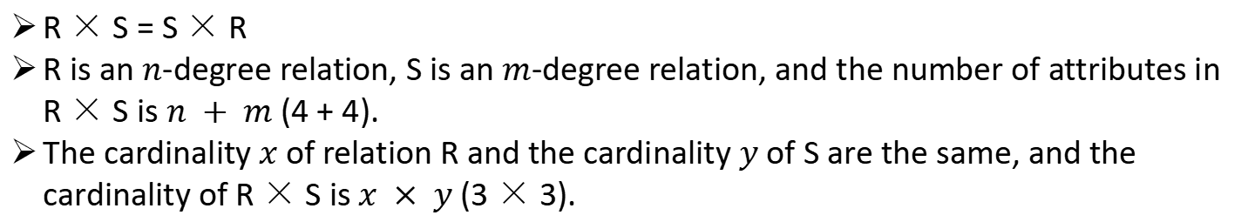
Example (Cartesian Product)
R × S = S × R
R is an $n$-degree relation, S is an $m$-degree relation, and the number of attributes in R × S is $n + m$ (4 + 4).
The cardinality $x$ of relation R and the cardinality $y$ of S are the same, and the cardinality of R × S is $x × y$(3 × 3).
Student
Sno | name | age | address
210110401 | Leo | 18 | 3010
210110402 | Emma | 17 | 3011
210110403 | Ben | 18 | 3011
(All students) (All courses)
Sno | name | age | address | Cno | Cname | Teacher | period
210110401 | Leo | 18 | 3010 | C1 | computer | Teacher1 | 52
210110401 | Leo | 18 | 3010 | C2 | physics | Teacher2 | 36
210110401 | Leo | 18 | 3010 | C3 | math | Teacher5 | 40
210110402 | Emma | 17 | 3011 | C1 | computer | Teacher1 | 52
210110402 | Emma | 17 | 3011 | C2 | physics | Teacher2 | 36
210110402 | Emma | 17 | 3011 | C3 | math | Teacher5 | 40
210110403 | Ben | 18 | 3011 | C1 | computer | Teacher1 | 52
210110403 | Ben | 18 | 3011 | C2 | physics | Teacher2 | 36
210110403 | Ben | 18 | 3011 | C3 | math | Teacher5 | 40
Course
Cno | Cname | Teacher | period
C1 | computer | Teacher1 | 52
C2 | physics | Teacher2 | 36
C3 | math | Teacher5 | 40

Slide 18
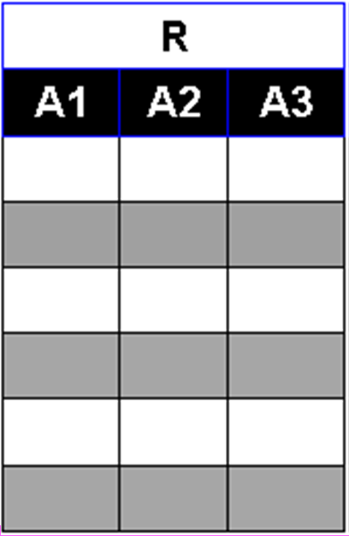
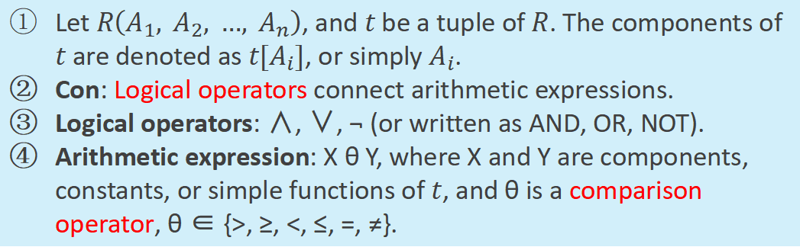

Relational Algebra Operations
Relational Operation: Select
  Definition: $σ_{con}(R)$is a set of tuples selected from relation $R$ that satisfy a given condition.
  Mathematical description: $σ_{con}(R) = \{t|t∈R∧con(t) = ′true′\}$
Let $R\left(A_{1}, A_{2}, …, A_{n}\right)$, and $t$ be a tuple of $R$. The components of $t$ are denoted as $t[A_{i}]$, or simply $A_{i}$.
Con: Logical operators connect arithmetic expressions.
Logical operators: ∧, ∨, ¬ (or written as AND, OR, NOT).
Arithmetic expression: X θ Y, where X and Y are components, constants, or simple functions of $t$, and θ is a comparison operator, θ ∈ {>, ≥, <, ≤, =, ≠}.

Slide 19
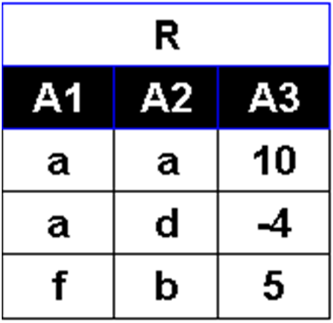
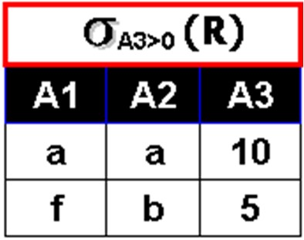
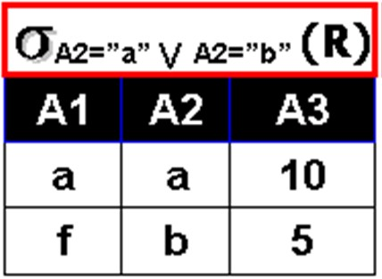
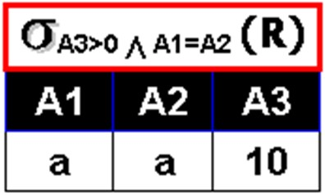
Example (Select)
Example 1 of the selection operation (abstract)

Slide 20
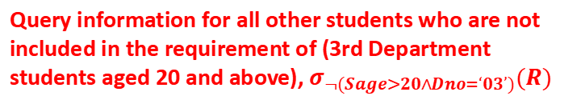


Example (Select)
Example 2 of selection operations (semantic)
R(Student)
Search for all 3-series or 5-series information, $σ_{DNo=‘03’∨DNo=‘05’}(R)$
Sno | Sname | Ssex | Sage | Dno | Sclass
210110101 | Bob | M | 21 | 03 | 2101
210110102 | Marry | F | 19 | 03 | 2101
210110103 | Tom | M | 20 | 03 | 2101
210110201 | Jerry | M | 18 | 04 | 2102
210110202 | Steve | M | 21 | 04 | 2102
210110303 | Lily | F | 19 | 05 | 2103
Sno | Sname | Ssex | Sage | Dno | Sclass
210110101 | Bob | M | 21 | 03 | 2101
210110102 | Marry | F | 19 | 03 | 2101
210110103 | Tom | M | 20 | 03 | 2101
210110303 | Lily | F | 19 | 05 | 2103
Query information for all other students who are not included in the requirement of (3rd Department students aged 20 and above), $σ_{¬(Sage>20∧Dno=‘03’)}(R)$
Search for information on all students under the age of 20, $σ_{Sage<20}(R)$
Sno | Sname | Ssex | Sage | Dno | Sclass
210130102 | Marry | F | 19 | 03 | 301
210130103 | Tom | M | 20 | 03 | 301
210140201 | Jerry | M | 18 | 04 | 402
210140202 | Steve | M | 21 | 04 | 402
210140203 | Lily | F | 19 | 04 | 402
Sno | Sname | Ssex | Sage | Dno | Sclass
210110102 | Marry | F | 19 | 03 | 2101
210110201 | Jerry | M | 18 | 04 | 2102
210110303 | Lily | F | 19 | 05 | 2103

Slide 21
Relational Algebra Operations
Example 3 of Selection Operations (Semantic)
Selection operations choose rows from a given relation that satisfy certain conditions.
The writing of the conditions is important, especially when different operators are used together. Pay attention to the operator precedence, which, from highest to lowest, is { brackets; θ; ¬; ∧; ∨ }
For example:
  Sage<20 ∨ Sage>18 ∧ Dno = “03”
  (Sage<20 ∨ Sage>18) ∧ Dno = “03”

Slide 22
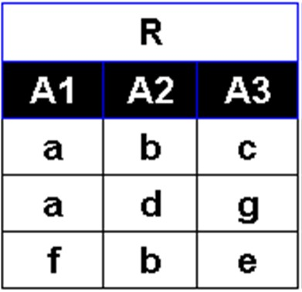
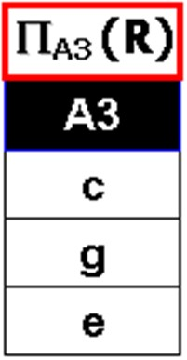
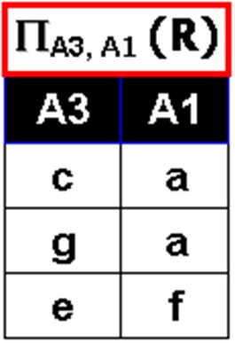
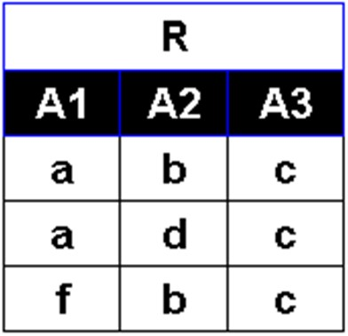
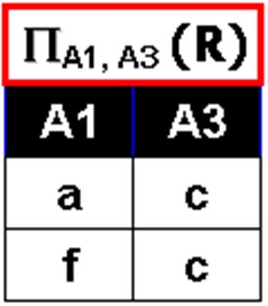
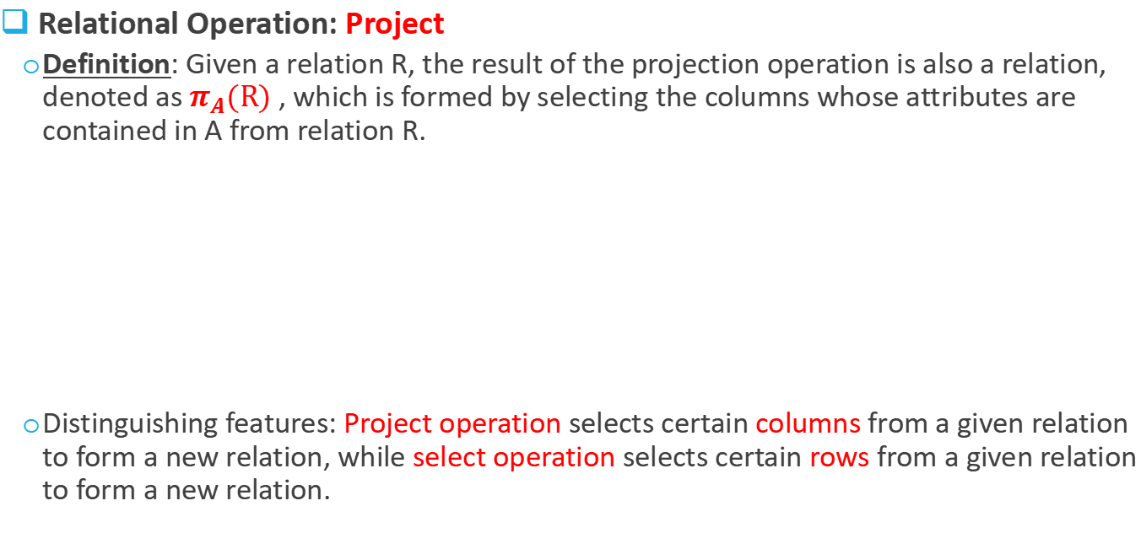
Relational Algebra Operations
Relational Operation: Project
  Definition: Given a relation R, the result of the projection operation is also a relation, denoted as $π_{A}(R)$, which is formed by selecting the columns whose attributes are contained in A from relation R.
  Distinguishing features: Project operation selects certain columns from a given relation to form a new relation, while select operation selects certain rows from a given relation to form a new relation.
Example 1 (abstract)
Duplicate tuples should be removed after projection.

Slide 23
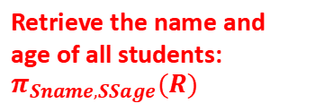
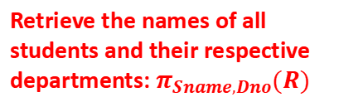
Example (Project)
Example 2 of project operation (semantic)
Retrieve the name and age of all students: $π_{Sname,SSage}(R)$
Retrieve the names of all students and their respective departments: $π_{Sname,Dno}(R)$
R(Student)
Sno | Sname | Ssex | Sage | Dno | Sclass
210130101 | Bob | M | 21 | 03 | 301
210130102 | Marry | F | 19 | 03 | 301
210130103 | Tom | M | 20 | 03 | 301
210140201 | Jerry | M | 18 | 04 | 402
210140202 | Steve | M | 21 | 04 | 402
210140203 | Lily | F | 19 | 04 | 402
Sname | Sage
Bob | 21
Marry | 19
Tom | 20
Jerry | 18
Steve | 21
Lily | 19
Sname | Dno
Bob | 03
Marry | 03
Tom | 03
Jerry | 04
Steve | 04
Lily | 05

Slide 24
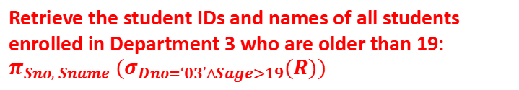

Example (Select and Project)
Examples of using project and select operations together (semantic).
Retrieve the student IDs and names of all students enrolled in Department 3 who are older than 19: $π_{Sno, Sname} (σ_{Dno=‘03’∧Sage>19}(R))$
R(Student)
Sno | Sname | Ssex | Sage | Dno | Sclass
210130101 | Bob | M | 21 | 03 | 301
210130102 | Marry | F | 19 | 03 | 301
210130103 | Tom | M | 20 | 03 | 301
210140201 | Jerry | M | 18 | 04 | 402
210140202 | Steve | M | 21 | 04 | 402
210140203 | Lily | F | 19 | 04 | 402
Sno | Sname
210130101 | Bob
210130102 | Marry
210130103 | Tom
Search for the student IDs and names of all male students enrolled in Department 4.
$$π_{Sno, Sname}(σ_{DNo=‘04’∧Ssex=‘M’}(R))$$
Users can query the data they are interested in by using projection and selection operations as needed.
Sno | Sname
210140201 | Jerry
210140202 | Steve

Slide 25
Exercise
Query all the female students (Sno, Sname) who are not from department ‘03’.
Query all the students (Sno, Sname) who are not in the above result.
Sno | Sname | Ssex | Sage | Dno | Sclass
210130101 | Bob | M | 21 | 03 | 301
210130102 | Marry | F | 19 | 03 | 301
210130103 | Tom | M | 20 | 03 | 301
210140201 | Jerry | M | 18 | 04 | 402
210140202 | Steve | M | 21 | 04 | 402
210140203 | Lily | F | 19 | 04 | 402

Slide 26
Relational Algebra Operations
Relational Operation: θ-Join
  Project and select operations operate on a single relation (table), while practical applications often involve operations between multiple tables.
  For example, querying the names of students whose scores are above 90 (involving Student, Course, SC)
  This requires a θ-join operation.

Slide 27
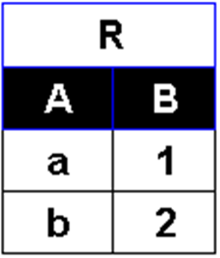
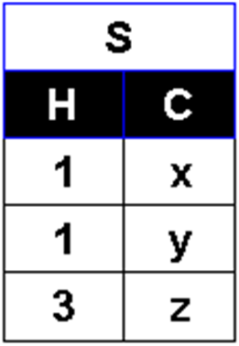
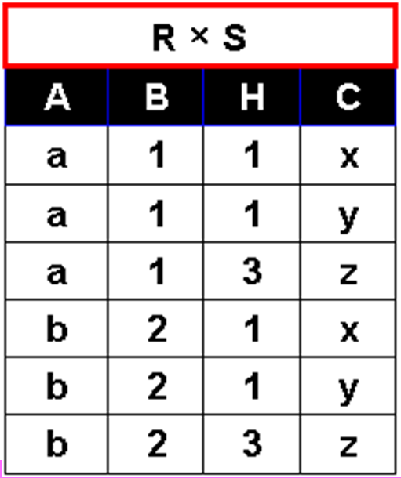
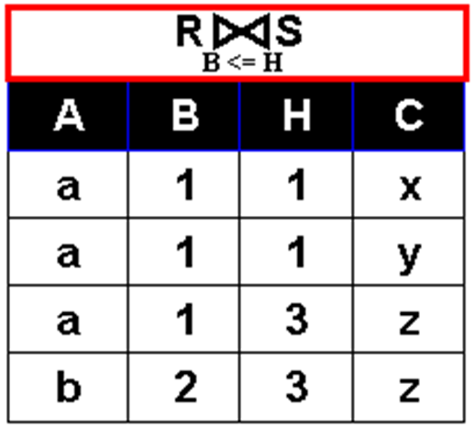


Relational Algebra Operations
Relational Operation: θ-Join
  Definition: Given relations R and S, the result of the θ join operation between R and S is also a relation, denoted as , which is composed of tuples selected from the Cartesian product of relations R and S that satisfy the θ condition between attribute A in R and attribute B in S.
$$R⋈S$$
$$AθB$$

Slide 28
Example (θ-Join)
Examples of using θ-Join operation (semantic).
Employee table: Worker(Wno, Wname, Wsex, Wage, Degree)
Job restriction table: Position(Type, Limited_Degree)
The positions being applied for must be filled by individuals with at least the minimum educational qualifications required. Find the names of all employees and the names of the positions they may be applying for.
worker
Wno | Wname | Wsex | Wage | Degree
01 | Bob | M | 35 | 1
02 | Marry | F | 49 | 3
03 | Tom | M | 55 | 2
position
Type | Limited_Degree
Team leader | 1
Project Manager | 2
Department Manager | 3
1: Bachelor's Degree
2: Master's Degree
3: Doctoral Degree

Slide 29
Example (θ-Join)
The positions being applied for must be filled by individuals with at least the minimum educational qualifications required. Find the names of all employees and the names of the positions they may be applying for.
^{π}Wname, Type^{(worker}
position)
degree >= limited_degree
Step 1: Perform a generalized Cartesian product on the two tables (worker and position).
(All workers) with (all positions) ← generalized Cartesian product
Wno | Wname | Wsex | Wage | Degree | Type | Limited_Degree
01 | Bob | M | 35 | 1 | Team leader | 1
01 | Bob | M | 35 | 1 | Project Manager | 2
01 | Bob | M | 35 | 1 | Department Manager | 3
02 | Marry | F | 49 | 3 | Team leader | 1
02 | Marry | F | 49 | 3 | Project Manager | 2
02 | Marry | F | 49 | 3 | Department Manager | 3
03 | Tom | M | 55 | 2 | Team leader | 1
03 | Tom | M | 55 | 2 | Project Manager | 2
03 | Tom | M | 55 | 2 | Department Manager | 3
×
×
×

Slide 30
Example (θ-Join)
The positions being applied for must be filled by individuals with at least the minimum educational qualifications required. Find the names of all employees and the names of the positions they may be applying for.
^{π}Wname, Type^{(worker}
position)
degree >= limited_degree
Step 2: Select tuples from the generalized Cartesian product that satisfy the condition (degree >= limited_degree).
Step 3: Perform a projection operation on (Wname, Type) to obtain the final result.
All workers and their eligible positions.
Wno | Wname | Wsex | Wage | Degree | Type | Limited_ Degree
01 | Bob | M | 35 | 1 | Team leader | 1
02 | Marry | F | 49 | 3 | Team leader | 1
02 | Marry | F | 49 | 3 | Project Manager | 2
02 | Marry | F | 49 | 3 | Department Manager | 3
03 | Tom | M | 55 | 2 | Team leader | 1
03 | Tom | M | 55 | 2 | Project Manager | 2
Wname | Type
Bob | Team leader
Marry | Team leader
Marry | Project Manager
Marry | Department Manager
Tom | Team leader
Tom | Project Manager

Slide 31

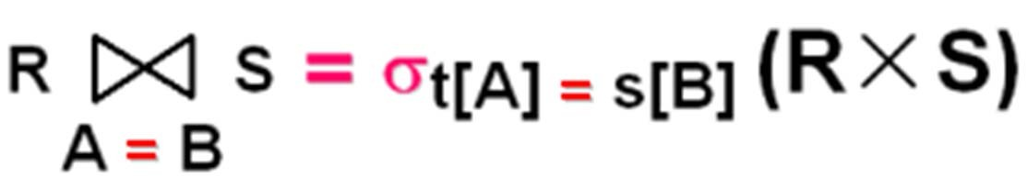
Relational Algebra Operations
Relational Operation: Equi-Join
  Definition: Given relations R and S, the result of an equi-join operation on R and S is also a relation, denoted as , which is composed of tuples selected from the Cartesian product of relations R and S where the values ​​of attribute A in R are equal to the values ​​of attribute B in S.
  Mathematical Description:
  When the operator in an θ-join is "=", it is an equi-join, a special case of the θ-join.
  Not all tuple combinations in a generalized product are meaningful, and the number of tuple combinations in a generalized product is enormous. Therefore, using θ-join/equi-join operations can significantly reduce the amount of intermediate results stored and improve speed.

Slide 32
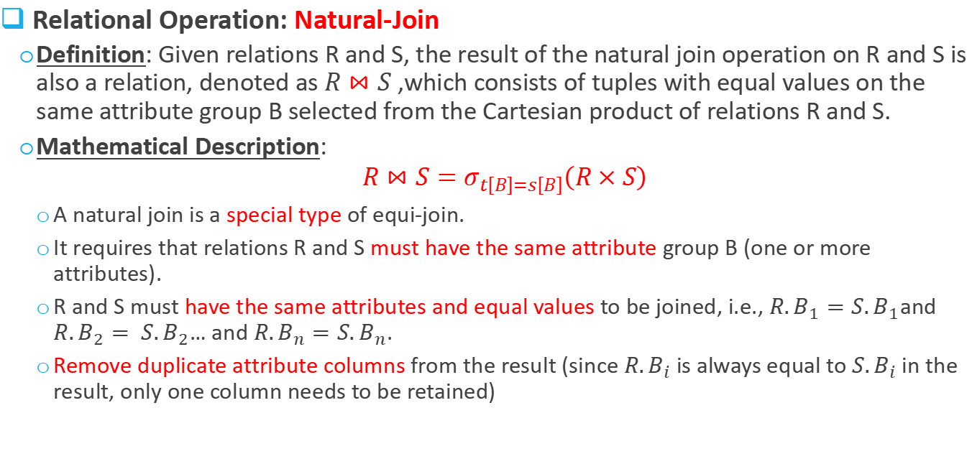
Relational Algebra Operations
Relational Operation: Natural-Join
  Definition: Given relations R and S, the result of the natural join operation on R and S is also a relation, denoted as $R⋈S$ ,which consists of tuples with equal values ​​on the same attribute group B selected from the Cartesian product of relations R and S.
  Mathematical Description:
  $$R⋈S=σ_{t\left[B\right]=s\left[B\right]}\left(R×S\right)$$
    A natural join is a special type of equi-join.
    It requires that relations R and S must have the same attribute group B (one or more attributes).
    R and S must have the same attributes and equal values ​​to be joined, i.e., $R.B_{1}=S.B_{1}$and $R.B_{2}= S.B_{2}$… and $R.B_{n}=S.B_{n}$.
    Remove duplicate attribute columns from the result (since $R.B_{i}$ is always equal to $S.B_{i}$ in the result, only one column needs to be retained)

Slide 33
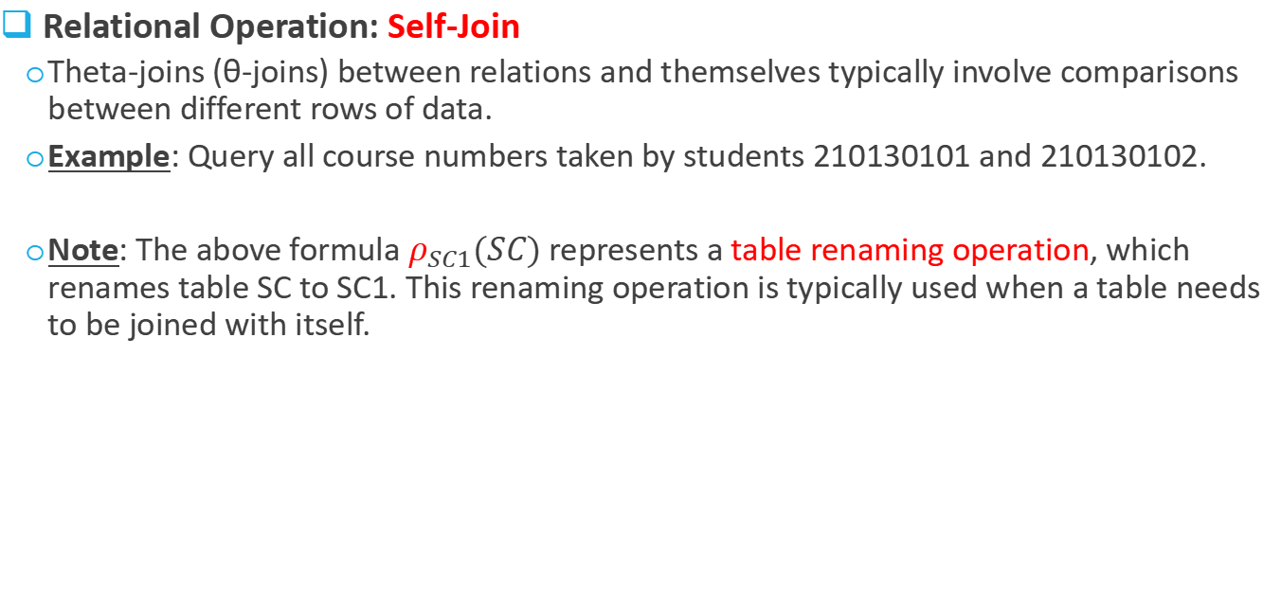
Relational Algebra Operations
Relational Operation: Self-Join
  Theta-joins (θ-joins) between relations and themselves typically involve comparisons between different rows of data.
  Example: Query all course numbers taken by students 210130101 and 210130102.
  Note: The above formula $ρ_{SC1}(SC)$ represents a table renaming operation, which renames table SC to SC1. This renaming operation is typically used when a table needs to be joined with itself.
^{π}SC.Cno ^{(σ}SC.Sno='210130101’ ∧ SC1.Sno='210130102’^{(SC}
ρ _{SC1} (SC))
SC.Cno= SC1.Cno
SC(Sno=‘210110101’) |  |  | SC1(Sno=‘210110102’)
Sno | Cno | Score | Sno | Cno | Score
210130101 | 001 | 92.0 | 210130102 | 001 | 55.0
210130101 | 002 | 85.0 | 210130102 | 002 | 90.5
210130101 | 003 | 88.0 | 210130102 | 003 | 80.0
Cno
001
002
003

Slide 34
Relational Algebra Operations
Relational Operation: Outer-Join
  Definition: When two relations R and S are joined, if a tuple in relation R (or S) cannot find a matching tuple in S (or R), in order to avoid the loss of tuple information, the tuple is joined with a tuple in S (or R) that is assumed to exist and contains all null values, and placed in the result relation. This type of join is called an outer join.
R
S
Outer joins of R and S (with equal City values)
Sno | City
S7 | London
S8 | Paris
S9 | Harbin
Pno | City
P7 | London
P8 | NewYork
P9 | Beijing
Sno | R.City | Pno | S.City
S7 | London | P7 | London
NULL | NULL | P8 | NewYork
NULL | NULL | P9 | Beijing
S8 | Paris | NULL | NULL
S9 | Harbin | NULL | NULL

Slide 35
Exercise
Write SQL for the following relational algebra query
^{π}SC.Cno ^{(σ}SC.Sno='210130101’ ∧ SC1.Sno='210130102’^{(SC}
ρ _{SC1} (SC))
SC.Cno= SC1.Cno

Slide 36
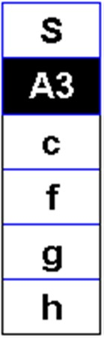
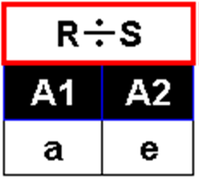
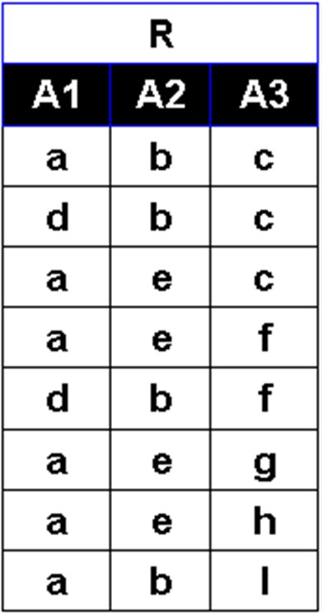
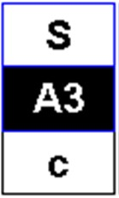
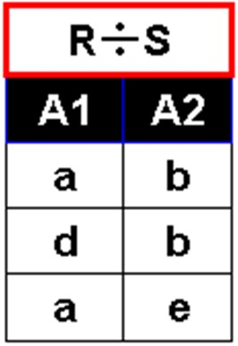
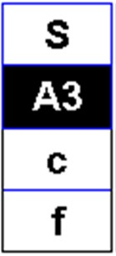
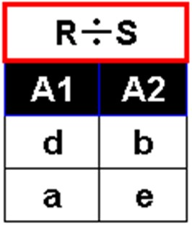
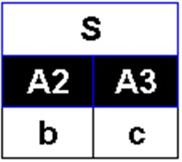
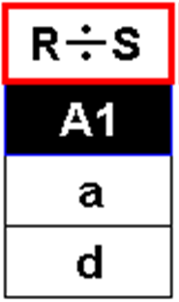
Relational Algebra Operations
Relational Operation: Division
  Example 1 of the division operation
In R, tuples that are combinations of all tuples in S (i.e., Cartesian products) on columns other than S appear in R.
(3)
(1)
(2)
(4)

Slide 37

Example (Division)
Example 2 of the division operation
Find the student ID of students who have taken all courses.
$$π_{SNo,CNo}(SC)÷π_{CNo}(SC)$$
SC（Student course selection table）
Sno | Cno | Score
210130101 | 001 | 92.0
210130101 | 003 | 88.0
210130101 | 003 | 90.0
210140202 | 001 | 90.5
210140202 | 002 | 88.0
210140201 | 001 | 93.0
210140201 | 002 | 95.0
210140202 | 001 | 89.0
Course（Course table）
Cno | Cname | Chours | Credit | TNO
001 | Database | 40 | 6 | 001
003 | Data Structure | 40 | 6 | 003
002 | Math | 80 | 12 | 004
Sno of students who have taken all courses
Sno
210130101

Slide 38
Overview of Query Processing
Basic Steps in Query Processing
  Query Processing refers to the series of activities involved in retrieving data from a database.
  These activities include translating SQL queries into expressions that can be executed at the physical layer of the file system, performing various transformations to optimize the query, and executing the query itself.
SQL query
Parser and translator
relational algebra expression
Query optimizer
System
Catalog
query-execution plan
Query
executor
Database
query result

Slide 39

Overview of Query Processing
Parser and translator
  The parser and translator transform an SQL query into a relational algebra expression.
Example (Parsing and translation)
  Relations: Teacher (ID, Name, Dno, salary ), Dept (Dno, Dname)
  SQL:
    select salary, Dname from Teacher Natural Join Dept where salary < 75000;
  Relational algebra expression:
  $$π_{salary,Dname}\left(σ_{salary<75000}\left(Teacher⋈Dept\right)\right)$$

Slide 40

Overview of Query Processing
Query Optimizer
  The query optimizer transforms a relational algebra expression into an equivalent expression with the highest execution efficiency, ultimately producing a Query Execution Plan.
  The query plan is typically represented as a tree structure, where each node corresponds to a basic operation.
Initial relational algebra expression
Equivalent algebraic relation expression
Query execution plan

Slide 41
Overview of Query Processing
Query Executor
  The query executor executes queries according to the query execution plan provided by the query optimizer.
  Query processing: Query Evaluation/Query Execution
Example: Query execution plan

Slide 42
Measures of Query Cost
The cost of query processing can be measured by the usage of various resources, including disk storage, CPU time spent executing a query, and communication costs in parallel/distributed database systems.
The cost of accessing data on disk is usually the most significant, as disk access is slower than memory operations.

Slide 43
Measures of Query Cost
How a DBMS measures the quality of its physical query plan:
  Number of I/O accesses (most important): How many data blocks are read and written. Assume DBMS data blocks = disk data blocks
  CPU time
  Memory usage cost (matched to the number and size of buffers)
  Intermediate result storage cost
  Computational load (e.g., searching records, merging records, sorting records, calculating field values, etc.)
  Network communication load, etc.

Slide 44


Query Plan Execution Scheme
Strategy 1: Materialization
  Materialized execution: Each intermediate result of the operation is created (materialized) and then used for the next level of operation.
  Operations in the query plan are executed from bottom to top.
  Each intermediate result is written to a temporary relation file as input for subsequent operations.
$$π_{S\#,Sname}\left(σ_{C\#="001"∧Student.S\#=SC.S\#}\left(Student×SC\right)\right)$$
$$Temp 1←Student ⋈SC$$
$$Temp 2←σ_{C\#="001"}\left(Temp 1\right)$$
$$Result←π_{S\#,Sname}\left(Temp 2\right)$$

Slide 45
Query Plan Execution Scheme
Strategy 2: Pipelining
  Pipeline execution: A pipeline is formed by combining several operations in a query plan. The result of one operation is not stored but directly passed to the next operation in the pipeline.
  Avoids the I/O overhead of creating temporary relations and reading/writing temporary relation files.
  Users can obtain query results as early as possible.
  Almost all DBMSs employ pipeline execution strategy to execute query plan.

Slide 46

Example
Student(SID, Sname, Sdept)
Pipeline execution: $π_{Sname}\left(σ_{Sdept=^{′}Math^{′}}\left(Student\right)\right)$
Retained due to meeting selection condition.
(1, Bob, Math) (1, Bob, Math) (Bob) …
Input buffer
SID | Sname | Sdept
1 | Bob | Math
2 | Steve | Math
3 | Ruby | Music
4 | Tom | English
Select
Operation
Project
Operation
Output buffer
R
Tuple-by-Tuple Processing

Slide 47
Example
Student(SID, Sname, Sdept)
Pipeline execution: $π_{Sname}\left(σ_{Sdept=^{′}Math^{′}}\left(Student\right)\right)$
Discarded due to unmet selection condition.
(3, Ruby, Music) (3, Ruby, Music)
Input buffer
SID | Sname | Sdept
1 | Bob | Math
2 | Steve | Math
3 | Ruby | Music
4 | Tom | English
Select
Operation
Project
Operation
Output buffer
R
Tuple-by-Tuple Processing

Slide 48

Implementation of Select Operation
Algorithm (linear search). Scan each file block and test all records to see whether they satisfy the selection condition.
  Cost estimate = $b_{r}$ block transfers + 1 seek
    $b_{r}$ denotes number of blocks containing records from relation r
  If selection is on a key attribute, can stop on finding record
    cost = ($b_{r}$ /2) block transfers + 1 seek
  Linear search can be applied regardless of selection condition or ordering of records in the file, or availability of indices

Slide 49
Implementation of Join Operation
Common implementation algorithms of join operations
  Nested-Loop Join
  Block Nested-Loop Join
  Indexed Join
  Sort-Merge Join
  Hash Join

Slide 50



Implementation of Join Operation
Nested-Loop Join: Requires no indices and can be used with any kind of join condition.
for each tuple $t_{R}$ in $R$ do begin // $R$ is called the outer relation for each tuple $t_{S}$ in $S$ do begin // $S$ is the inner relation
test pair ($t_{R},t_{S}$) to see if they satisfy the join condition θ
if they do, add $t_{R}×t_{S}$ to the result.
end
end
  $T_{R}$: Number of tuples in relation 𝑅;
  $T_{S}$: Number of tuples in relation 𝑆.
  Complexity: $𝒪(T_{R}×T_{S} )$

Slide 51
Query Optimization Overview
Motivation: Performance issues of relational databases
Example:
  Student: 10,000 student records (2,500 per year, four years)
  Course: 1,000 course records
  SC: 10,000 * 50 = 500,000 course selection records (10,000 students, each selecting 50 courses)
  Student × SC × Course: 10,000 * 50 * 10,000 * 1,000 records = 5 * 10¹² records
$$∏_{\text{Sname}}(σ_{\text{SC}\text{.}\text{C}\text{\#=}\text{Course}\text{.}\text{C}\text{\#}∧\text{Student}\text{.}\text{S}\text{\#}\text{=}\text{SC}\text{.}\text{S}\text{\#} ∧\text{Cname}\text{=′}\text{DB}\text{′}}(\text{Student}×\text{SC}×\text{Course}))$$

Slide 52
Example
The impact of the order of relational algebra operations on efficiency:
The following three relational algebra statements represent the same retrieval requirement, but which one is better?
∏_{S#,Sname,Score} (σ_{Cname=’DB’} ((Student ⨝ SC) ⨝ Course))
10000
500000
500000
1000
500000
∏_{S#,Sname,Score} (Student ⨝ (SC ⨝ (σ_{Cname=’DB’}Course)))
1000
500000
1
10000
2500(approximately)
2500(approximately)
∏_{S#,Sname,Score} (∏_{S#,Sname} Student ⨝ (SC ⨝ ∏_{C#} (σ_{Cname=’DB’} Course)))

Slide 53
Query Optimization Overview
Query optimization: The process of identifying the most efficient query execution plan from numerous query strategies to minimize database query execution time.
Three optimization levels:
  Semantic optimization: Optimizing queries by leveraging the semantics and integrity rules of the model.
  Logical query optimization: Optimizing the execution order of operations by utilizing syntactic structure.
  Physical query optimization: Optimizing the selection and execution order of access paths and execution algorithms.

Slide 54
Logical Query Optimization
Basic idea: Reorder operations in relational algebra to perform selection and projection as early as possible.
Overall Approach
select A1, …, An from R1, …, Rm where Cond ;
Which two of the five basic relational algebra operations can be reordered?
Compile
∏_{A1,...,An} (σ_{Cond} R1×...×Rm)
Semantic optimization
Logical optimization
The equivalence of expressions before and after reordering operations.
∏_{A1,...,An} (σ_{Cond} (( ∏_{a1}(σ_{Cond1}R1))×...×( ∏_{am}(σ_{Condm}Rm))))
The equivalence transformation theorem for relational algebra expressions and its proof (omitted).
Optimization algorithms for relational algebra expressions – Logical query plan formation.

Slide 55
Logical Query Optimization
Transformation of Relational Expressions: Two relational algebra expressions are said to be equivalent if the two expressions generate the same set of tuples on every legal database instance
  Note: order of tuples is irrelevant
  We don’t care if they generate different results on databases that violate integrity constraints
In SQL, inputs and outputs are multisets of tuples
  Two expressions in the multiset version of the relational algebra are said to be equivalent if the two expressions generate the same multiset of tuples on every legal database instance.
An equivalence rule says that expressions of two forms are equivalent
  Can replace expression of first form by second, or vice versa

Slide 56

Equivalence Rules
Let $E_{i}$ be relational algebra expressions, and $F_{i}$ be additional constraints on the attributes in $E_{i}$.
Theorem L1: Commutative Law of Joins and Products
Theorem L2: Associative Law of Joins and Products
Theorem L3: Projection Concatenation Law
Let the attribute set $\{A_{1},…,A_{n}\}⊆\{B_{1},…,B_{m}\},$and E be an expression, then we have:
∏_{A1,...,An} (∏_{B1,...,Bm} E) ≡ ∏_{A1,...,An} E
Theorem L4: Conjunctive selections can be split into individual selections.
σ_{F1} (σ_{F2} E) ≡ σ_{F1∧F2} E
（1）E₁ ⨝_{F} E₂ = E₂ ⨝_{F} E₁
（2）E₁ ⨝ E₂ = E₂ ⨝ E₁
（3）E₁ × E₂ = E₂ × E₁
（1）(E₁ ⨝_{F1} E₂) ⨝_{F2} E₃ = E₁ ⨝_{F1} (E₂ ⨝_{F2} E₃)
（2）(E₁ ⨝ E₂) ⨝ E₃ = E₁ ⨝ (E₂ ⨝ E₃)
（3）(E₁ × E₂) × E₃ = E₂ × (E₁ × E₂)

Slide 57

Equivalence Rules
Let $E_{i}$ be relational algebra expressions, and $F_{i}$ be additional constraints on the attributes in $E_{i}$.
Theorem L5: Commutative Law of Selection and Projection
Suppose that condition F only involves attributes $\{A_{1},…, A_{n}\},$and E is a relational expression, then we have:
∏_{A1,...,An} (σ_{F} E) ≡ σ_{F} (∏_{A1,...,An} E)
Theorem L6: Commutative Law of Selection and Product
If condition F only involves the attributes in $E_{1}$, then:
σ_{F} E₁×E₂ ≡ σ_{F} (E₁)×E₂
If $F=F_{1}∧F_{2}$, and $F_{1}$ and $F_{2}$ only involve attributes in $E_{1}$ and $E_{2}$ respectively, then:
σ_{F} E₁×E₂ ≡ σ_{F1} (E₁)×σ_{F2} (E₂)
If $F=F_{1}∧F_{2}$, where $F_{1}$ only involves attributes in $E_{1}$, and $F_{2}$ involves attributes in both $E_{1}$ and $E_{2}$, then:
σ_{F} E₁×E₂ ≡ σ_{F2} (σ_{F1} (E₁)×E₂)

Slide 58

Equivalence Rules
Let $E_{i}$ be relational algebra expressions, and $F_{i}$ be additional constraints on the attributes in $E_{i}$.
Theorem L7: Commutative Laws of Projection and Product
Let $A_{1}, …, A_{n}$be some attributes appearing in $E_{1}$ or $E_{2}$, where $B_{1}, …, B_{m}$appear in $E_{1}$, and the remaining attributes $C_{1}, …, C_{k}$appear in $E_{2}$. And $\left\{A_{1}, …, A_{n}\right\}= \left\{B_{1}, …, B_{m}\right\}∪\left\{C_{1}, …, C_{k}\right\},$ then:
∏_{A1,...,An} (E₁×E₂) ≡ (∏_{B1,...,Bm} E₁)×(∏_{C1,...,Ck} E₂)
Theorem L8: Commutative Law of Choice and Union
σ_{F} (E₁∪E₂) ≡ (σ_{F} E₁)∪(σ_{F} E₂)
Theorem L9: Commutative Law of Choice and Difference
σ_{F} (E₁－E₂) ≡ (σ_{F} E₁)－(σ_{F} E₂)
Theorem L10: Commutative Law of Projection and Union
Given the relational algebra expression $E = E_{1}∪E_{2}$, where $A_{1}, …, A_{n}$are some attributes of $E$, then:
∏_{A1,...,An} (E₁∪E₂) ≡ (∏_{A1,...,An} E₁)∪(∏_{A1,...,An} E₂)
Note: Theorems L8 and L10 require that $E_{1}$ and $E_{2}$ are union compatible.

Slide 59
Equivalence Rules
Instructor (ID, name, dept_name, salary)
Teaches(ID, course_id, sec_id, semester, year)
Course(course_id, title, dept_name, credits)
Q: Please find the names of all the teachers in the Music Department who taught courses in 2017, and the names of all the courses each person taught that year.
Relational algebra expression:
Π_{name, title}(σ_{dept_name= ‘Music’∧year = 2017} (instructor ⨝ (teaches ⨝ Π_{course_id, title} (course))))

Slide 60
Equivalence Rules
Instructor (ID, name, dept_name, salary)
Teaches(ID, course_id, sec_id, semester, year)
Course(course_id, title, dept_name, credits)
Q: Please find the names of all the teachers in the Music Department who taught courses in 2017, and the names of all the courses each person taught that year.
Based on the Associative Law of Joins (L2), modify the join order (the optimal order can be determined based on the specific cost estimate):
  Π_{name, title}(σ_{dept_name= ‘Music’∧year = 2017}((instructor ⨝ teaches) ⨝ Π_{course_id, title} (course)))

Slide 61
Equivalence Rules
Instructor (ID, name, dept_name, salary)
Teaches(ID, course_id, sec_id, semester, year)
Course(course_id, title, dept_name, credits)
Q: Please find the names of all the teachers in the Music Department who taught courses in 2017, and the names of all the courses each person taught that year.
Based on L4 and L6, the selection operation will be pushed down before the join:
  Π_{name, title}((σ_{dept_name= ‘Music’}(instructor)⨝ σ_{year = 2017} (teaches))⨝ Π_{course_id, title} (course))

Slide 62
Equivalence Rules
Instructor (ID, name, dept_name, salary)
Teaches(ID, course_id, sec_id, semester, year)
Course(course_id, title, dept_name, credits)
Q: Please find the names of all the teachers in the Music Department who taught courses in 2017, and the names of all the courses each person taught that year.
Π_{ID, name}
Π_{ID, course_id}
According to L5, projection is performed before joining to reduce the size of intermediate results:
  Π_{name, title}(Π_{ID, name}(σ_{dept_name= ‘Music’}(instructor))⨝ Π_{ID, course_id}(σ_{year = 2017} (teaches))
  ⨝ Π_{course_id, title} (course))

Slide 63
Equivalence Rules
Instructor (ID, name, dept_name, salary)
Teaches(ID, course_id, sec_id, semester, year)
Course(course_id, title, dept_name, credits)
Q: Please find the names of all the teachers in the Music Department who taught courses in 2017, and the names of all the courses each person taught that year.
Π_{ID, name}
Π_{ID, course_id}
According to L5, projection is performed before joining to reduce the size of intermediate results:
  Π_{name, title}(Π_{ID, name}(σ_{dept_name= ‘Music’}(instructor))⨝ Π_{ID, course_id}(σ_{year = 2017} (teaches))
  ⨝ Π_{course_id, title} (course))

Slide 64

Physical Query Optimization
Overall Approach
  The same logical query scheme, but different execution algorithms, will have different costs.
  Example: Execution plans for
  $$σ_{Cname="Data Structure"}(Course)$$
    Option 1: Linear scan
    Option 2: Using the Cname B+ tree index on the Course
  When the conditions are more complex, there are even more options available.
  The plan with the lowest cost is selected to generate the physical query plan.
σ_{Cname=‘Data Structure’}

Slide 65
Example
Physical Query Plan
Logical Query Plan
Merge Join
τ_{course_id}
Merge Sort
τ_{course_id}
Merge Sort
Π _{name, course_id}
Π _{name, course_id}
Nested-loop Join
Π_{ID, name}
Π_{ID, course_id}
Π_{ID, name}
Π_{ID, course_id}
Linear Scan
B+ Tree Index Scan

Slide 66

Physical Query Optimization
Cost Estimation
  Given the statistics of each relation in expression E:
    $T_{R}$ or T(R): Number of tuples in relation R;
    $B_{R}$ or B(R): Number of disk blocks in relation R;
    $I_{R}$ or I(R): Number of bytes per tuple in relation R;
    $f_{R}$ or f(R): Block factor of R, i.e., the number of tuples of R that can be stored in one block;
    V(R, A): Number of distinct values ​​for attribute A in R, i.e., the number of $\prod_{A}{(R)}$;
    SC(R, A): Cardinality of attribute A in R, the average number of records satisfying the equality condition on A.
Given an expression E, how do we calculate the number of tuples T(E) and the number of distinct values ​​V(E, A) on attribute A?
Calculating T(A), V(E, A), etc., before E is actually obtained is very difficult.
Therefore, we need to “estimate”, specifically cost estimation.

Slide 67

Cost Estimation (Project)
Estimate the size of a projection $\prod_{L}{(R)}$
  $T\left(\prod_{L}{\left(R\right)}\right)=T\left(R\right)$
  The projection operation only rounds down columns, without changing rows, so it doesn't eliminate duplicates.
  The projection operation doesn't reduce the number of rows, but it may effectively reduce the number of blocks storing the result relationship.
Example
  Disk block size = 1024 bytes, tuple length of R = 100 bytes, 8 tuples/block, T(R) = 10,000, then B(R) = 10000/8 = 1250;
  Tuple length of $\prod_{L}{(R)}$ = 20 bytes, 50 tuples/block, then B($\prod_{L}{(R)}$) = 10000/50 = 200

Slide 68

Cost Estimation (Select)
Estimate the size of a selection $S=σ_{A=c}(R)$
  T(S) lies between 0 and T(R)–V(R, A)+1
    At most: each tuple with a distinct value for attribute A has only one instance, and the rest are tuples where A=c
  Estimation: T(S) = T(R)/V(R, A)
    Assuming the number of tuples with distinct values ​​for attribute A is uniformly distributed
Estimate the size of a selection $S=σ_{A<c}(R)$
  T(S) is between 0 and T(R)
    At most: all tuples satisfy the condition
  Estimation: T(S) = T(R)/2
    Assuming $c$ is uniformly distributed in the order of values ​​within A

